Slide 1
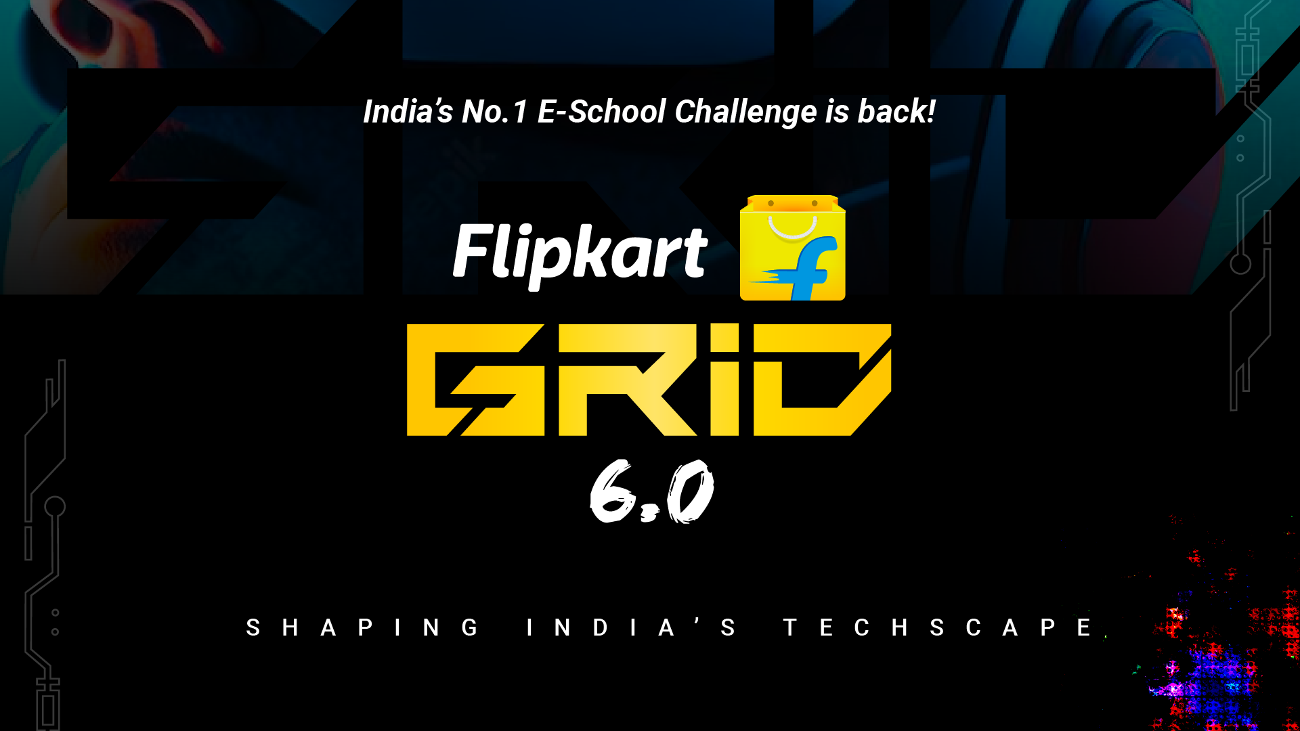
Notes:
#

Slide 2
Team Intro
Title: Smart Vision + Flipkart GRiD 6.0 - Robotics Challenge
Team Name: Tech Hunters
Team Members: I.Dileep Kumar (Team Leader)
Tarun Yegireddi
College/University: Gayatri Vidya Parishad College of Engineering (Autonomous)
Date: 19-10-2024

Slide 3
Executive Summary:
Implementation Plan For The Four Tasks:
To implement the solution for the four tasks, we first built two models and then integrated them into a unified flow.
Data Collection and Model Training:
We collected a dataset of 20,000 product images from online Flipkart stores using the Chrome extension Fatkun Batch Download Image. This dataset was used to train and fine-tune the models.
1.Object Detection (YOLOv8) Model:
We trained the YOLOv8 object detection model on the dataset using a Google Colab T4 GPU to count the number of objects.
The Roboflow platform was utilized for image labeling, and augmentation techniques were applied to ensure model robustness and to cover diverse data during training.
This model is optimized for efficiently detecting and identifying various product classes.
2. OCR Extraction (Qwen2-VL-2B) Model:
To extract OCR information (e.g., brand name, product name, MRP, product description), we fine-tuned the Qwen2-VL-2B Vision-Language model on product images and corresponding product details using a Google Colab T4 GPU.
The model was then quantized for faster inference, achieving 95% accuracy during testing.
The model handles multiple complex cases, such as:
Multiple language support
Handwritten recognition
Digital document recognition
Poor image quality
Complex layouts
Distorted text

Slide 4
Executive Summary:
Integrated Workflow:
Step1: Preprocessing
External cameras capture frames, which are preprocessed by adjusting brightness, balancing colors, and removing noise to enhance image quality for accurate detection.
Step 2: Object Detection
The preprocessed frames are passed to the fine-tuned YOLOv8 model to detect and extract all product images from the frames.
Step 3: OCR Processing
The detected product images are cropped and saved as individual images.
Each individual image is mapped to a corresponding Vision-Language Model (Qwen2-VL-2B) using multithreading. This model is responsible for extracting key details from the image as per the problem requirements:
Brand name, product name, MRP, product description
Expiry date details and MRP validation
Shelf life prediction for perishable items (For non-perishable items, the shelf life is determined from the expiry details)

Slide 5
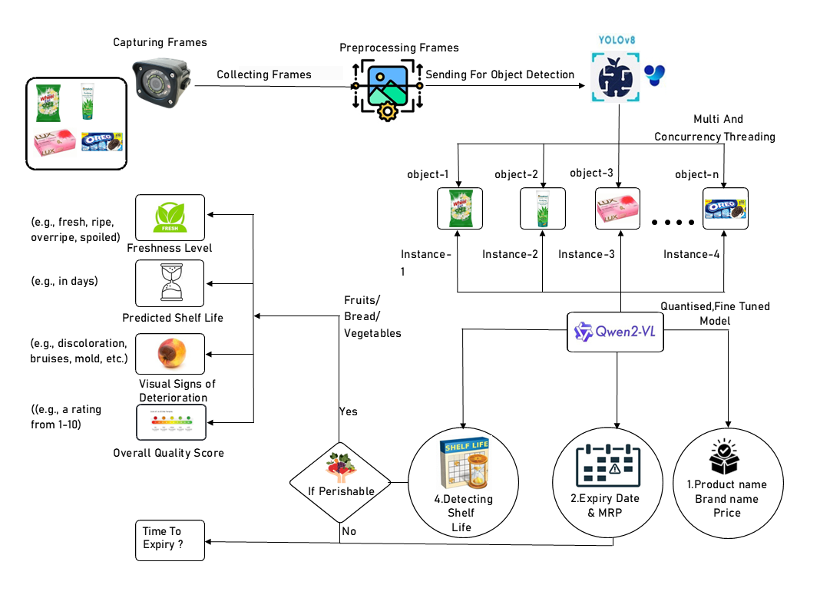










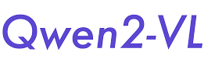
Technical Approach:
Image Capture:
External cameras capture images of goods before packing.
Preprocessing:
Adjust brightness and color balance.
Remove image noise.
Normalize and enhance image quality
Object Detection (YOLOv8):
Fine-tuned YOLOv8 model detects and identifies products
from images.
Custom dataset created using Roboflow for accurate detection.
Detected objects are cropped for detailed analysis.
Product Analysis (Qwen2-VL-2B instruct):
Cropped images processed to extract product details:
Product Name & Brand: Confirms item identity.
Expiry Date: Extracts and verifies freshness.
Quantity: Ensures correct count of goods.
Tech Stack:
Freshness Prediction:
For fruits/vegetables, predicts shelf life based on visual assessment.
Integration:
Automated workflow providing real-time quality checks, enhancing speed and accuracy.

Slide 6
Github Link :- https://github.com/TARUN-YEGIREDDI/Smart- Vision-Technology-FlipkartRobotics
Hardware Specifications:-
YoloV8 custom training – T4 GPU
Qwen Model Finetuning and Quantization – T4 GPU
Video Link :- https://tarun-yegireddi.github.io/Smart-Vision-Technology-FlipkartRobotics/robo.mp4
1. Overall Code :- https://colab.research.google.com/drive/1vQu7K7ShwP4ti9CQGss50B0hpZ3RNduU?authuser=1
2. Data collection :- https://app.roboflow.com/object-detection-ub97b/grocery-and-fruitsvegetables/1
3. Preprocessing :- https://colab.research.google.com/drive/1vQu7K7ShwP4ti9CQGss50B0hpZ3RNduU?authuser=1#scrollTo=sisWZyJ8z6_x&line=254&uniqifier=1
4. OCR to extract details from image/label (Brand Name, Pack Size, and Product Description Extraction Model) :- https://colab.research.google.com/drive/1vQu7K7ShwP4ti9CQGss50B0hpZ3RNduU?authuser=1#scrollTo=TlwW9QheXvhZ&line=12&uniqifier=1
5. Using OCR to get expiry date details :- https://colab.research.google.com/drive/1vQu7K7ShwP4ti9CQGss50B0hpZ3RNduU?authuser=1#scrollTo=FKVyUL-nruRY&line=1&uniqifier=1
6. Image recognition and counting :- https://colab.research.google.com/drive/1vQu7K7ShwP4ti9CQGss50B0hpZ3RNduU?authuser=1#scrollTo=sqV7mdSUzo2Y&line=40&uniqifier=1
7. Detecting freshness of fresh produce - https://colab.research.google.com/drive/1vQu7K7ShwP4ti9CQGss50B0hpZ3RNduU?authuser=1#scrollTo=IZH48IzvVMum&line=11&uniqifier=1

